Slide 1
Smart Irrigation System (Basic prototype)
By Samuel Batchelor

Slide 2
Purpose of the Project
To create a smart watering system for the (lots) of plants in my garden
Monitor their environment
How often they are being watered
How warm and humid their environment is
Know when they need to be watered
Tracking their watering frequency

Slide 3
Why
Use cases:
For someone who doesn’t want to have to drag up the garden hose each time.
Automated watering schedules
Gathering data for a group of plants to get an idea of what conditions they prefer.
Water different garden areas based on plant needs.

Slide 4
Design
Start off with the basics
Detect soil moisture
Detect temperature and humidity
Create a basic menu system (displayed with i2c LCD)

Slide 5
Factors that influence moisture sensor readings
The amount of water given to the plant
More water = higher moisture readings
Soil type
Higher drainage = greater moisture drop
Environmental
More light or heat = greater moisture drop

Slide 6
Problems
The less deeper the soil moisture sensor = the lower the moisture reading
Having the sensor deeper could provide better readings
Low and high moisture readings can vary based on soil type
Not really a consistent set range
Plants can have different watering needs
Thus different moisture ranges

Slide 7
Improvements
Add a water pump
Monitor water levels for that water pump
Add a light sensor
Add an addressable LED to convey plant health
Add a rain sensor
Possibly make a bigger menu system (scrap ISR and adding more buttons)
Soil moisture menu
Water levels menu
Climate menu
Light levels menu

Slide 8
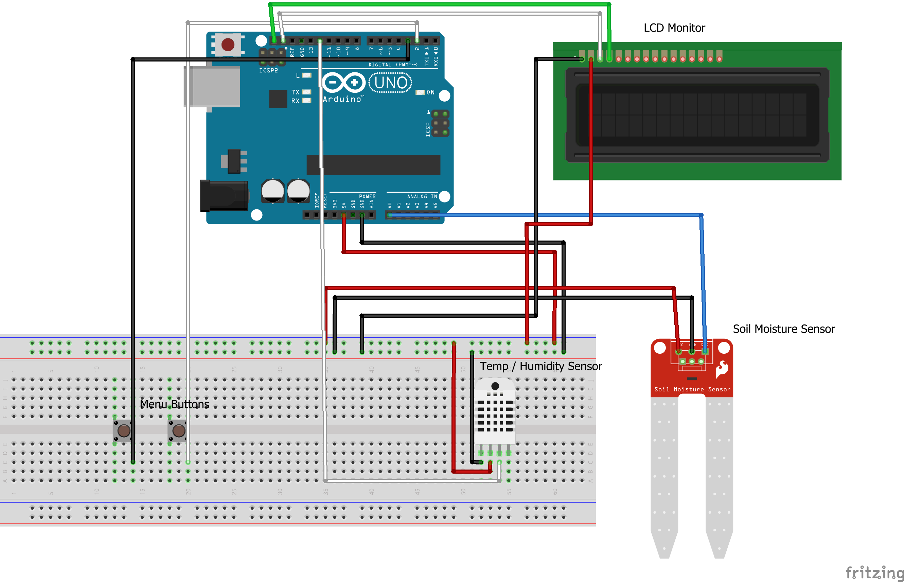
Breadboard layout

Slide 9
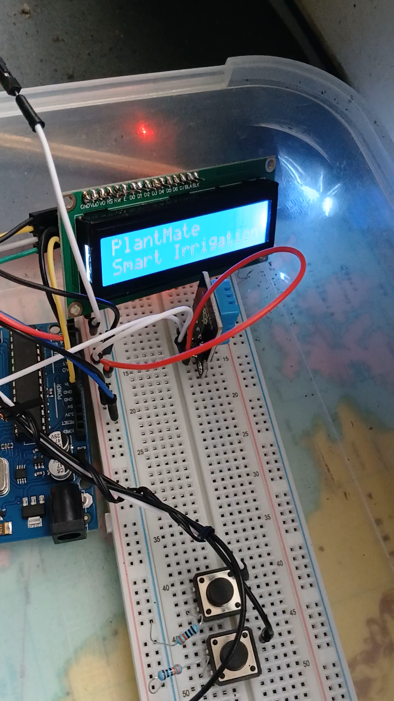
Video demonstration

Slide 10
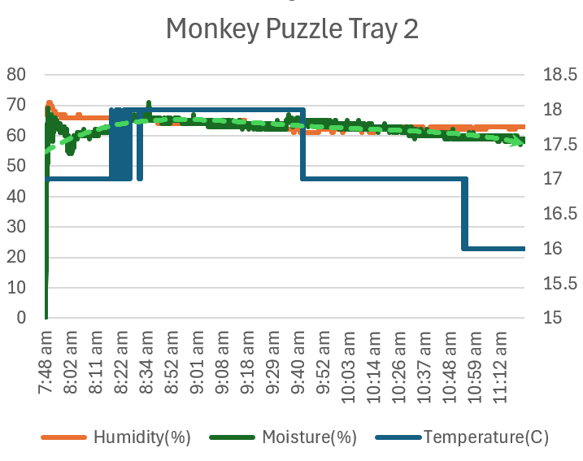
Recording data

